Slide 1
Luigi Ledda
Department of Agriculture
University of Sassari
lledda@uniss.it
"Spinoso sardo" globe artichoke: process and product innovation

Slide 2
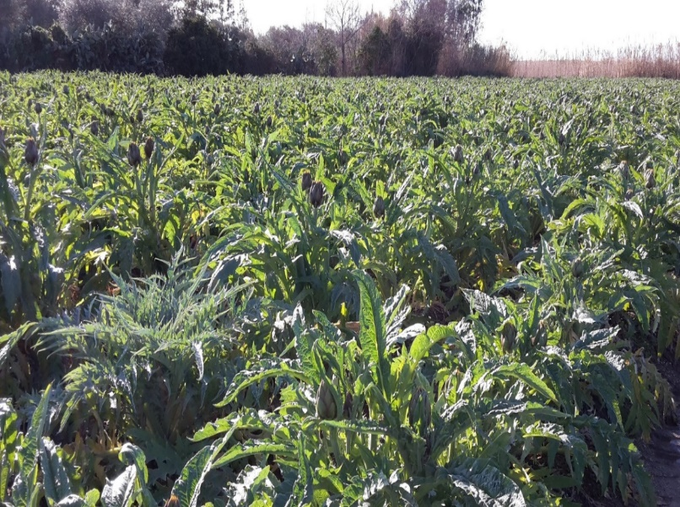
CULTIVATION OF ARTICHOKE: Actual Issues
FALL OF PRODUCTIVITY
mainly for crop systems oriented to early production
reproductive materials not selected
high percentage of failed areas in the field
scarce uniformity of development
irregular thermo-pluviometric trends
intensive monoculture

Slide 3
CULTIVATION OF ARTICHOKE: Actual Issues
FALL OF PROFITABILITY
European and non-EU rivals most competitive than Sardinian farmers
poor strategies on productive sector organization and commercial aspects
increasing costs of inputs
any development on artichoke cropping system
LACK OF INNOVATION THAT ALLOWS
STRUCTURAL, TECHNOLOGICAL, AGRONOMIC
and COMMERCIAL MODERNIZATION

Slide 4
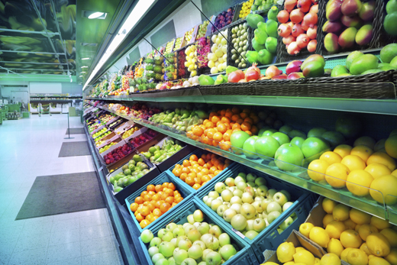
CULTIVATION OF ARTICHOKE: changes in competitive scenarios
CONSUMERS
Increasing attention towards quality, nutritional and health of food products
LEGISLATION
Higher qualitative standards,
incentives of environment friendly products and with geographical indication, encouragement of international commercial relations for a greater competitiveness
GDO
New contractual rules and new qualitative standards of product and service

Slide 5
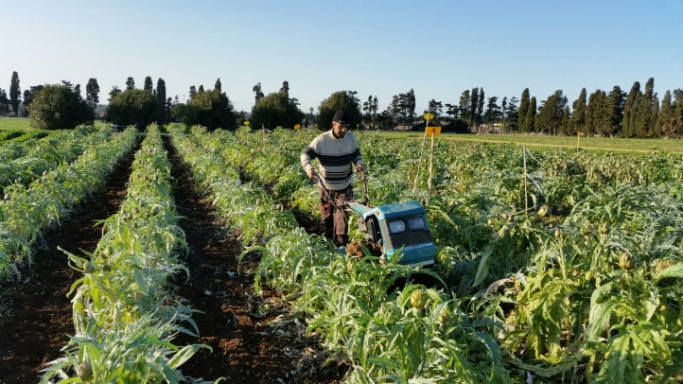
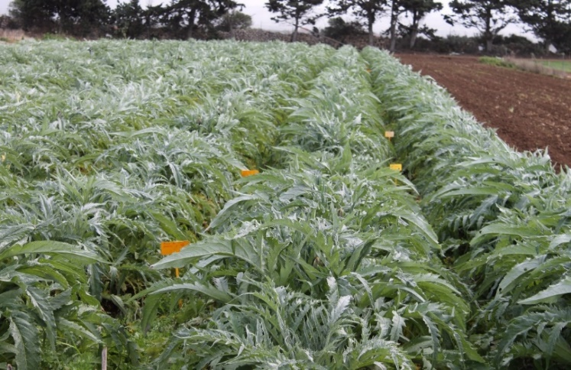
CULTIVATION OF ARTICHOKE: changes in competitive scenarios
Artichoke: Sardinian agriculture sector with social and economic KEY ROLE
SCIENTIFIC RESEARCH FOR INNOVATION
STRATEGIES OF ADAPTATION TO NEW CONDITIONS
FOR THE MODERNIZATION OF PRODUCTION SYSTEM

Slide 6
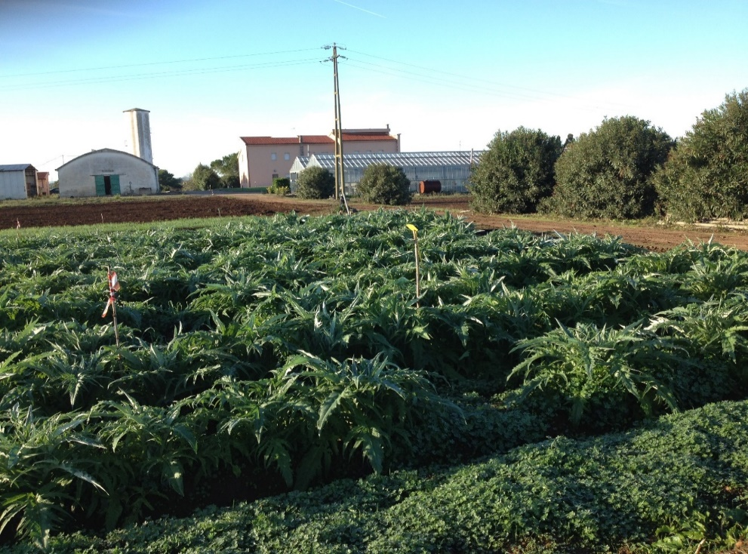
SCIENTIFIC RESEARCH, UNISS
Department of Agricolture
Section of Agronomy, Herbaceous Crops and Genetic
University of Sassari

Slide 7
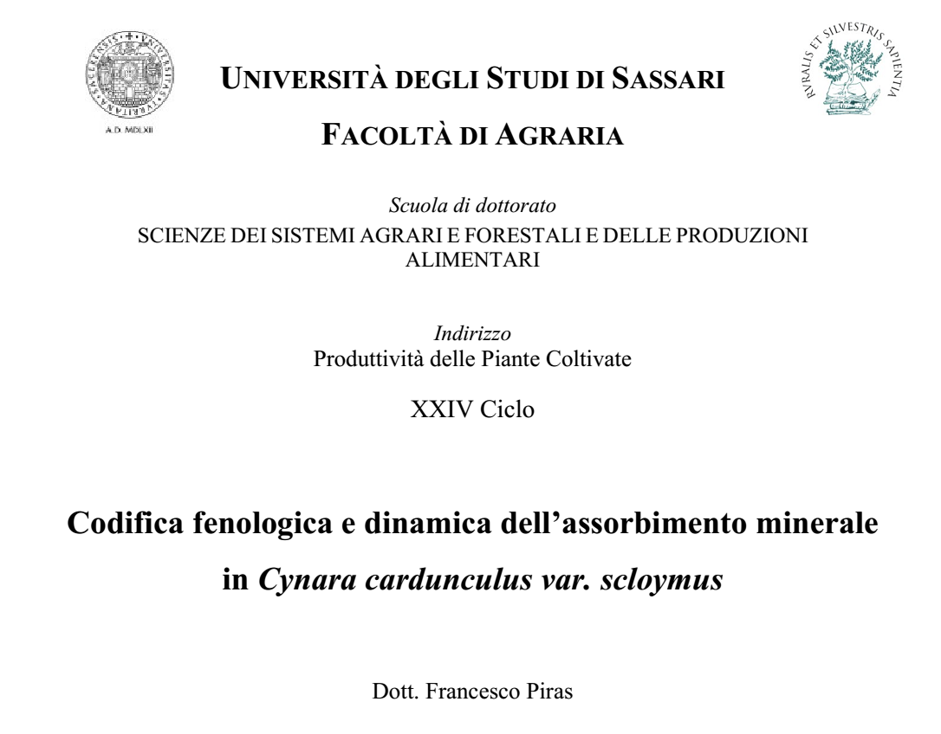
SCIENTIFIC RESEARCH, UNISS projects and results
«Coding of the artichoke BBCH scale for detailed description of the main phenological events, through the identification of main and secondary growth stages.»
«The phenological stages of growth are specific to the species. Instead, the timing of phenological stage vary in function of cultivars and transplantation date.»

Slide 8
SCIENTIFIC RESEARCH, UNISS projects and results
N, P e K ASSIMILATION CURVES
«The assimilation of the mineral elements follows the trend of accumulation biomass.
It is also affected
by climate, cultivar,
type of soil
and crop
management.»
 | STOCK REMOVAL (A.A .V.V.) Kg ha⁻¹ | REAL STOCK REMOVAL (Ledda e Piras, 2012) Kg ha⁻¹ | TYPICAL CONVENTIONAL FERTILIZATION Kg ha⁻¹
N | 250-300 | 120-150 | 300-400
P₂O₅ | 80-100 | 20-30 | 100-150
K₂O | 350-400 | 110-220 | 400-450

Slide 9
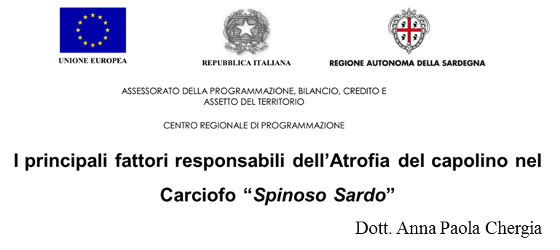
SCIENTIFIC RESEARCH, UNISS projects and results
Evaluation of the influence of temperature on atrophy of head artichoke
Site | Year I |  | Year II
 | Sprinkler Irrigation | Drip irrigation | Sprinkler Irrigation | Drip irrigation
CABRAS | 1,9 b | 5,8 a | 8,1 b | 11,1 a
OTTAVA | 1,8 b | 6,0 a | 5,9 b | 9,0 b
Average | 1,9 a | 5,9 b | 7,0 b | 10,5 a
Evaluation of the influence of crop nutrition on atrophy of head artichoke
head order | N1 160 kg ha⁻¹ | N2 200 kg ha⁻¹ | N3 240 kg ha⁻¹ | Average
I | 6,6 b | 6,9 b | 7,4 a | 7,0
II | 4,6 b | 4,7 b | 5,2 a | 4,8
III | 3,6 b | 3,7 a | 4,1 a | 3,8
Average | 4,9 | 5,1 | 5,6
Percentage of heads atrophic on total harvested

Slide 10
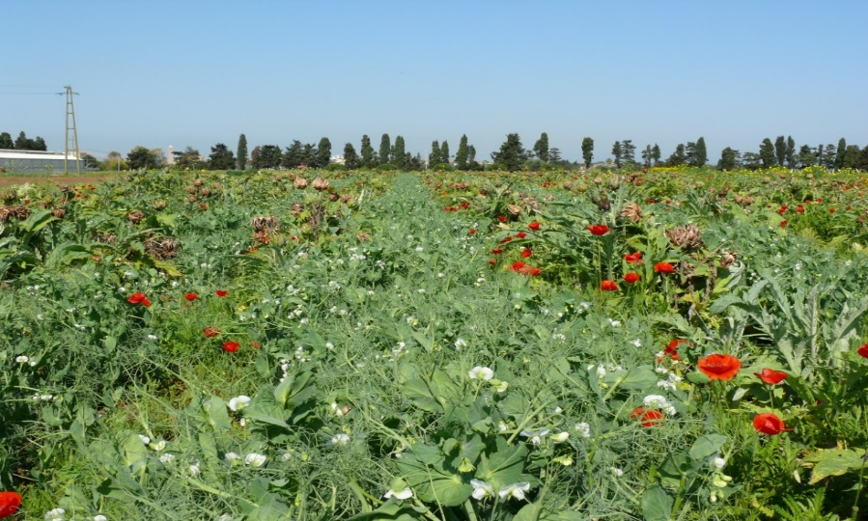
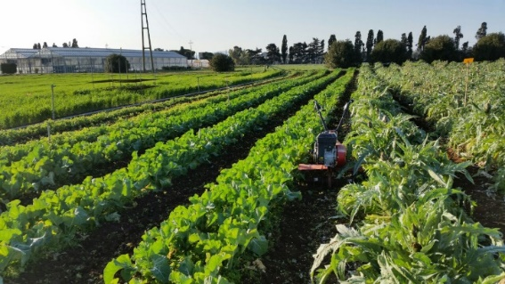
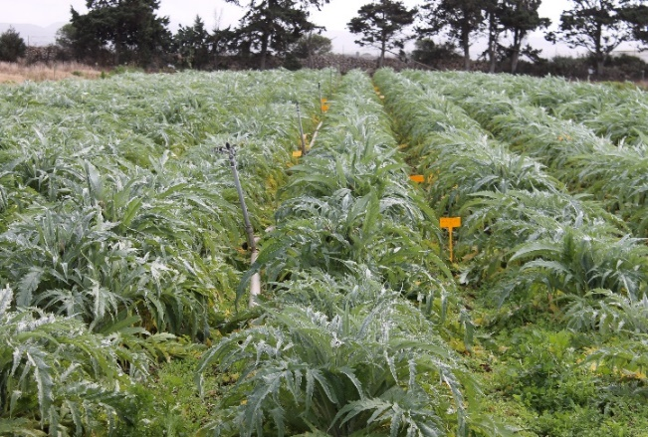
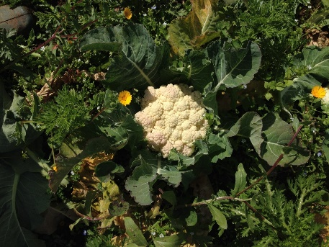
SCIENTIFIC RESEARCH, UNISS projects and results
Alternative management of
FERTILIZATION and WEED
Treatment "CONVENTIONAL"
a typical crop management
Treatment "ORGANIC" BIENNIAL
Treatment “ORGANIC” INTENSIVE
Exploitation of the legume crop benefits
Early chopping and burying of artichoke biomass and legumes

Slide 11
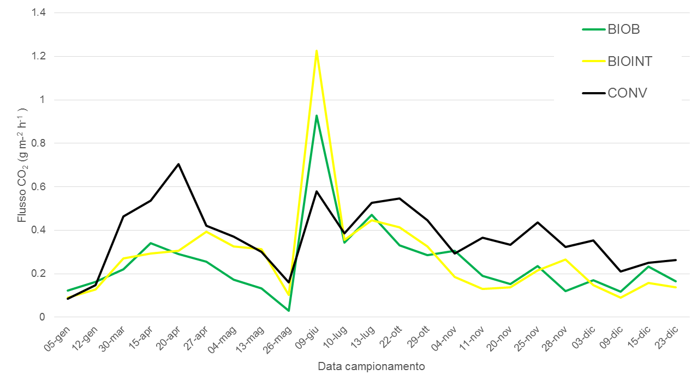
SCIENTIFIC RESEARCH, UNISS projects and results

Slide 12
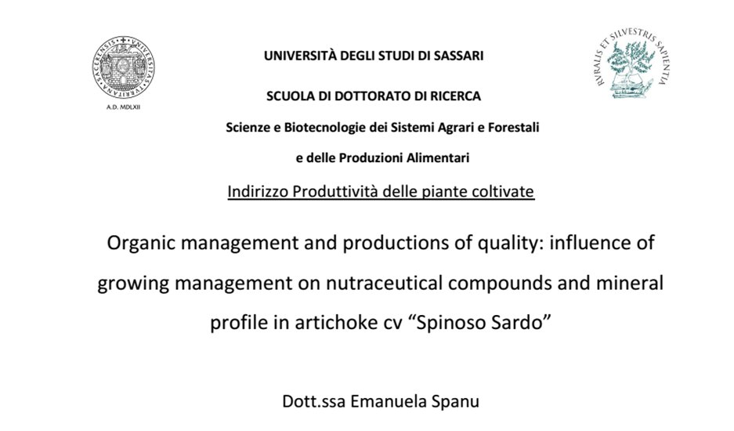
SCIENTIFIC RESEARCH, UNISS projects and results
IMPACT OF CROP MANAGEMENT ON NUTRACEUTICAL COMPOUNDS
AND MINERAL PROFILE IN GLOBE ARTICHOKE “SPINOSO SARDO”

Slide 13
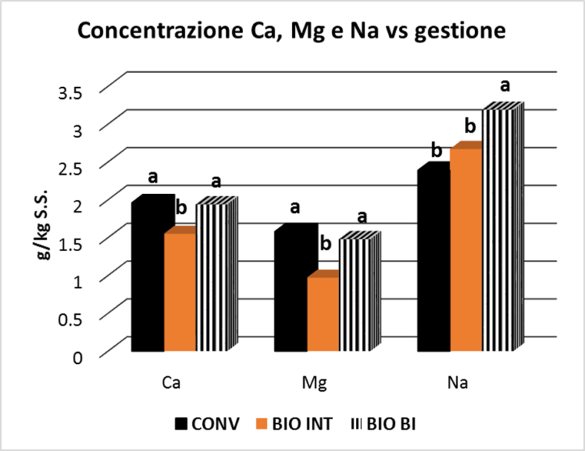
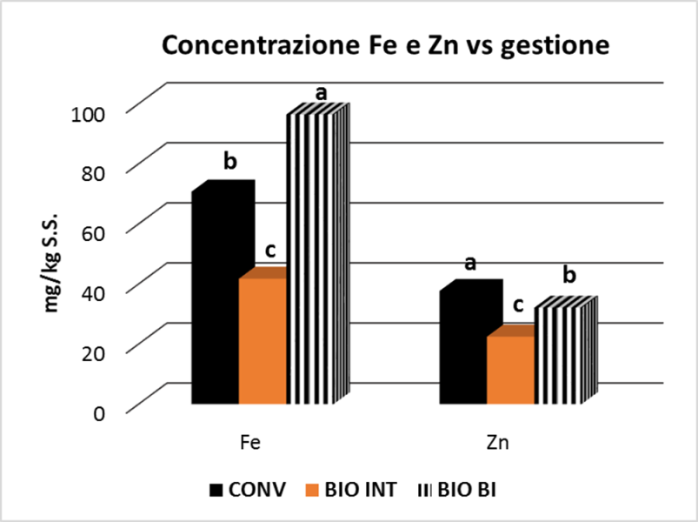
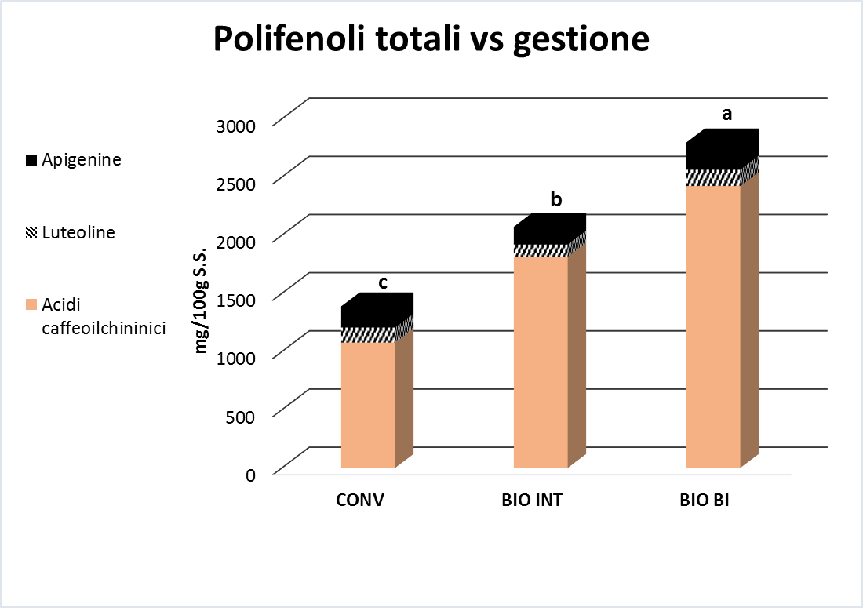
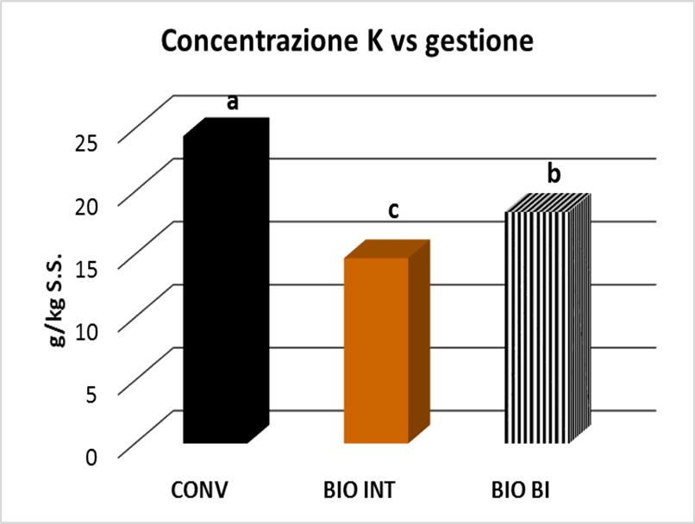
SCIENTIFIC RESEARCH, UNISS projects and results
MINERALS
the mineral profile is influenced more by thermo-pluviometric conditions than by different managements
the nutritional value of mineral component was high
POLIPHENOLS
α= 0.05
Higher concentrations of polyphenols in the “ORGANICS” managements

Slide 14
TRANSFER TO FARMS ACTIVITIES, UNISS projects
Ecocynara
Innovation towards sustainability at farm scale of artichoke "spinoso sardo" growing in a low input system
Scientific Manager: Dott. Luigi Ledda

Slide 15
TRANSFER TO FARMS ACTIVITIES, UNISS projects
 | CONVENTIONAL SYSTEM | ORGANIC SYSTEM
 | ARTICHOKE | ARTICHOKE | LEGUMES
INPUT
N FERTILIZATION Kg ha⁻¹ (N) | 21.0 | 0 | 0
N cover crop Kg ha⁻¹ (N) | 0 | 0 | 61.17
N ATMOSPHERIC CONTRIBUTIONS Kg ha⁻¹ (N) | 2.37 | 2.37
OUTPUT
YELD (KG D.M. ha⁻¹) | 580.61 | 518.40 | 0
REMOVAL Kg ha⁻¹ (N) | 11.95 | 10.67
INPUT - OUTPUT | 11.42 | -8.30 | 63.54
SURPLUS | 11.42 | 55.24
CONVENTIONAL SYSTEM | SISTEMA BIOLOGICO
ARTICHOKE | ARTICHOKE | LEGUMES
125.0 | 0 | 0
0 | 0 | 37.28
2.37 | 2.37
637.63 | 578.88 | 0
13.12 | 11.91 | 0
114.25 | -9.54 | 39.65
114.25 | 30.10

Slide 16
TRANSFER TO FARMS ACTIVITIES, UNISS projects
From -10% to -60% of atrophic heads in the two farms
The trend of production observed in the biological treatment is close to the natural emission rate of flower heads order

Slide 17
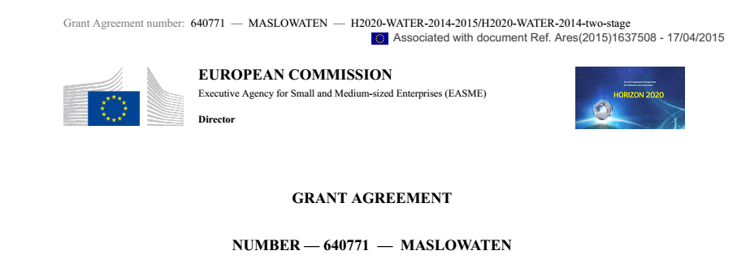
SCIENTIFIC RESEARCH, UNISS projetcs

Slide 18
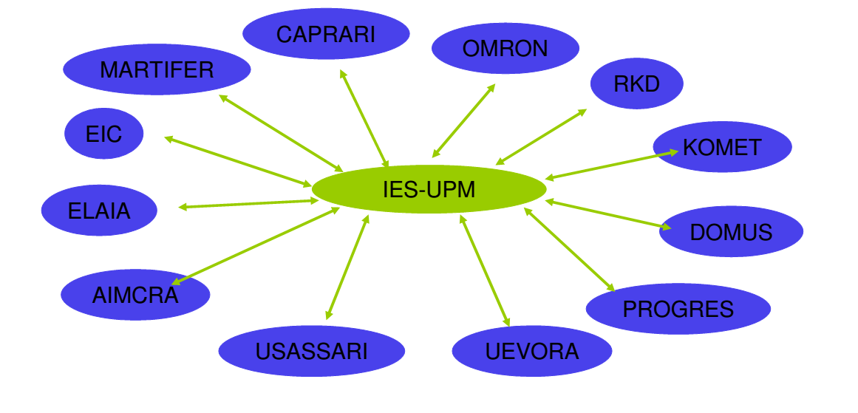
MASLOWATEN PROJECT
INTERDISCIPLINARY
APPROACH

Slide 19
WORK PACKAGES
1
Coordination and management of the consortium
2
Integration of Large PV pumps + Automatisms-ICT solutions-PA-Low pressure irrigation systems
3, 4, 5, 6 e 7
Market uptake: Validation of long-term viability of first application systems
Market replication: technical aspects for the bankability of the projects
Market replication: economical and social tools for the exploitation of the results
Market uptake: Dissemination among final users for the market uptake
IPR and exploitation management

Slide 20
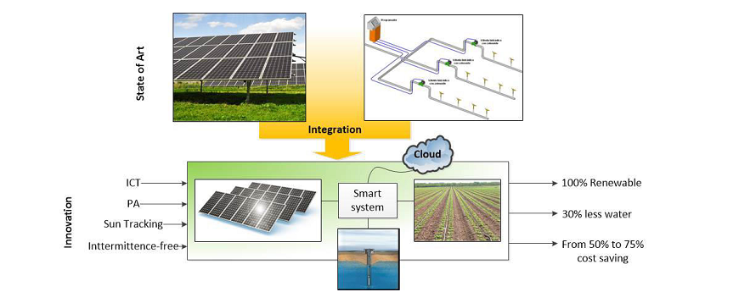
MASLOWATEN PROJECT
Solution based on LOW WATer-ENergy consumption
“Azienda SARCIOFO“ (Uri, Italy), the Italian demonstrator
Dedicated PV for energy supply
PV NOT connected to the grid
Automatic and precision irrigation

Slide 21
Luigi Ledda
Department of Agriculture
University of Sassari
lledda@uniss.it
"Spinoso sardo" globe artichoke: process and product innovation

