Slide 1
The Common Agricultural Policy

Slide 2
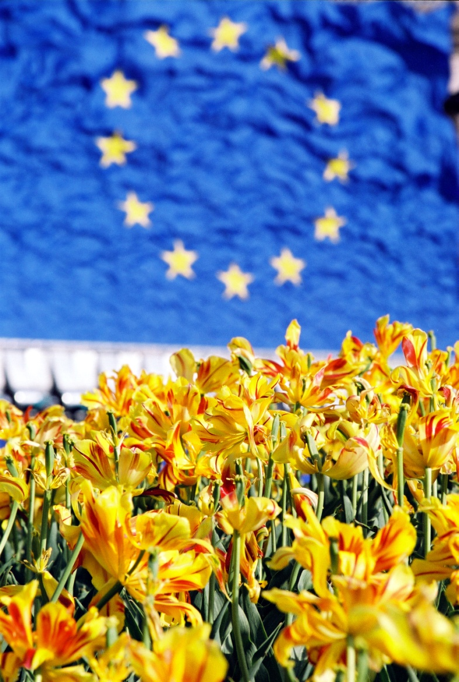
Outline
CAP – A Short Background
Europe’s Agricultural Timeline
Why do we need CAP?
Why is agricultural policy set at an EU level?
Funding CAP
A policy financed by the EU budget
Maltese agriculture at a glance
CAP in Malta

Slide 3
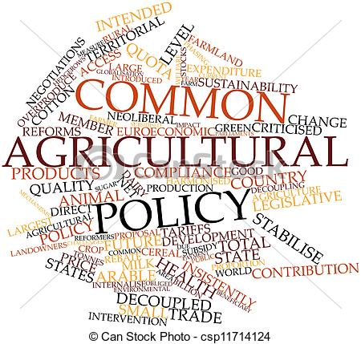
CAP – A Short Background
Cap has its roots in 1950s Western Europe;
The idea is a result of crippling agriculture and damage caused by years of war;
CAP aimed at:
encouraging better productivity in the food chain;
ensuring fair standard of living to the agricultural community;
market stabilisation; and
Ensuring availability of food supplies to EU consumers at reasonable prices.
Launched in 1962.

Slide 4
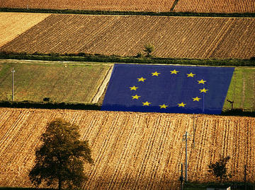
Europe’s Agricultural Timeline
1957
The Treaty of Rome creates the European Economic Community (the precursor of today’s EU), between six western European countries;
1962
The common agricultural policy is born. The CAP is foreseen as a common policy, with the objectives to provide affordable food for EU citizens and a fair standard of living for farmers
1984
The CAP falls victim to its own success. Farms become so productive that they grow more food than needed. The surpluses are stored and lead to ‘food mountains’. Several measures are introduced to bring production levels closer to what the market needs.

Slide 5
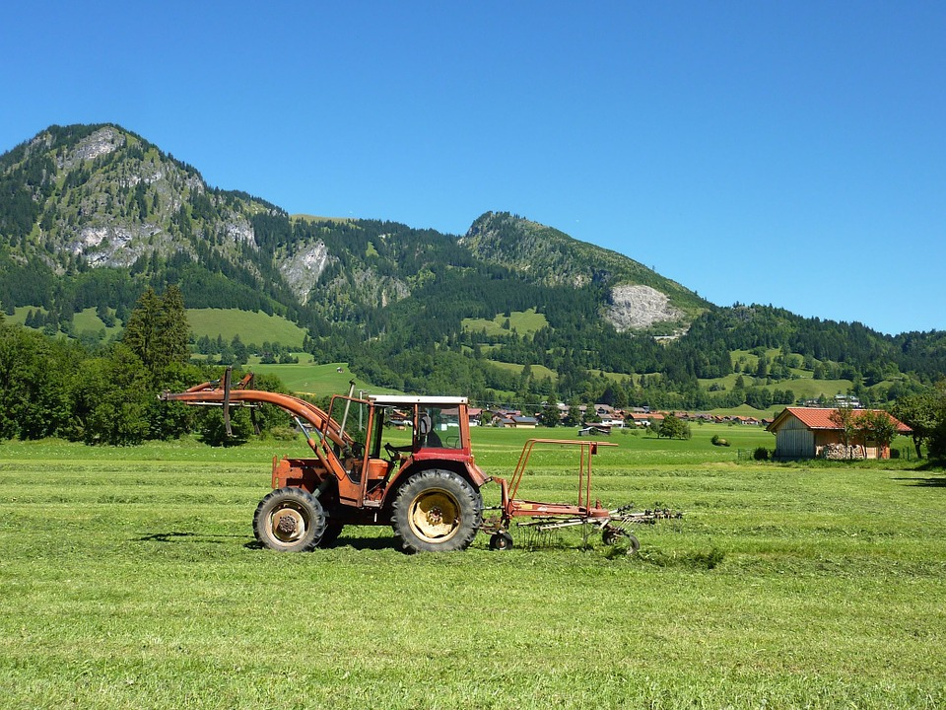
Europe’s Agricultural Timeline
1992
The CAP shifts from market support to producer support. Price support is scaled down, and replaced with direct aid payments to farmers. They are encouraged to be more environmentally friendly. The reform coincides with the 1992 Rio Earth Summit, which launches the principle of sustainable development.
2003
The CAP provides income support. A new CAP reform cuts the link between subsidies and production. Farmers now receive an income support payment, on condition that they look after the farmland and fulfil environmental, animal welfare and food safety standards
2013
The CAP is reformed to strengthen the competitiveness of the sector, promote sustainable farming and innovation and support jobs and growth in rural areas.

Slide 6
Why do we need CAP?
Challenges CAP has been addressing during the past 50 years:
improving agricultural productivity;
ensuring EU farmers can make a reasonable living;
food security – at a global level, food production will have to double in order to feed a population of 9 billion in 2050;
climate change and sustainable management of natural resources;
looking after the countryside across the EU and keeping the rural economy alive.

Slide 7
Why do we need CAP?
CAP
Food
Environment
Countryside

Slide 8
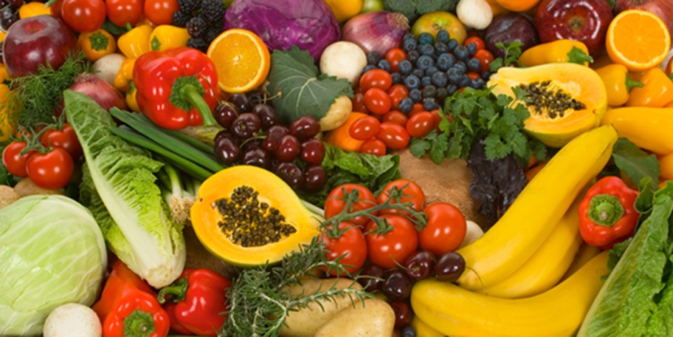
CAP is about our food
As a society, we can be sure that our farmers produce the food we need.
Our farmers produce an impressive variety of abundant, affordable, safe and good quality products.
Due to its exceptional agricultural resources the EU can play an important role in ensuring food security.

Slide 9
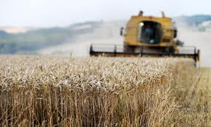
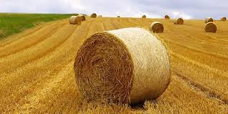
CAP is about our countryside
In all EU Member States. farmers keep the countryside alive and maintain the rural way of life.
If there were no farms or farmers, our hamlets, villages and market towns would be profoundly affected.
Farmers need machinery, buildings, fuel, fertilisers and healthcare for their animals (other roles include: preparing, processing and packaging food, others are involved in food storage, transport and retailing.
All in all, farming and food production are essential elements of our economy and society.

Slide 10
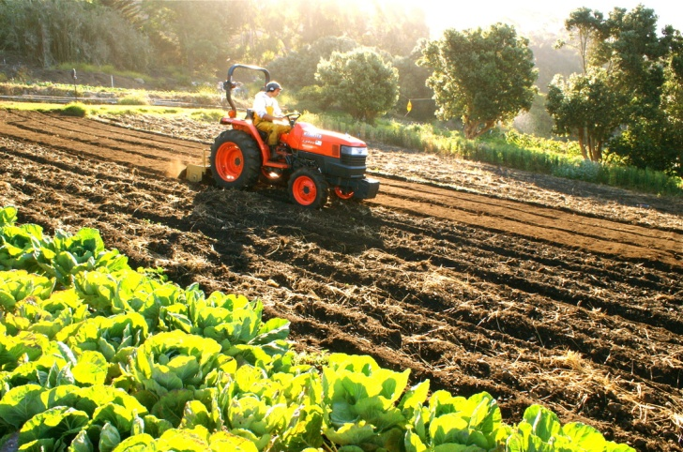
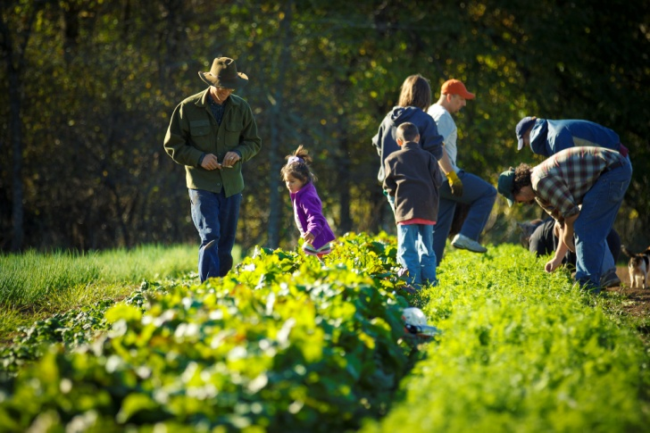
CAP is about our environment
Our countryside is not in its original natural state. It has been shaped by farming over the centuries.
Farmers manage the countryside for the benefit of us all.
They supply public goods — the most important of which is the good care and maintenance of our soils, our landscapes and our biodiversity.
To remunerate farmers for this service to society as a whole, the EU provides farmers with income support.
Farmers can be adversely affected by climate change. The CAP provides them with financial assistance to adjust their farming methods and systems to cope with the effects of a changing climate.

Slide 11
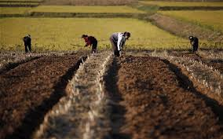
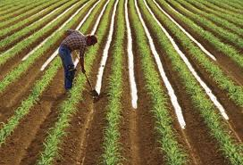
Why is agricultural policy set at an EU level?
The main aims of CAP are:
to improve agricultural productivity, so that consumers have a stable supply of affordable food, and
To ensure that EU farmers can make a reasonable living.
All the Member States share these two objectives, neither of which can be attained without providing financial support to farming and rural areas.

Slide 12
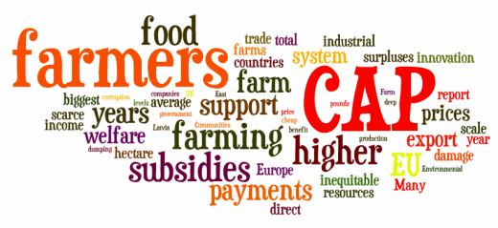
Why is agricultural policy set at an EU level? (cont.)
A collective EU policy makes for better use of budgetary resources than would the coexistence of 28 national policies.
A policy set at the European level ensures common rules in a single market; addresses market volatility where needed: addresses market volatility where needed; safeguards the progress made in recent reforms towards increased competitiveness of European agriculture and provides for a common trade policy allowing the EU to negotiate as one, vis-à-vis our global trading partners.

Slide 13
How agricultural policy works
Agricultural Policy
Market Support
Rural Development
Income Support

Slide 14
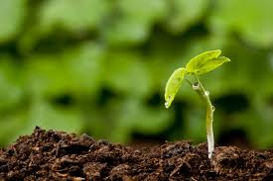
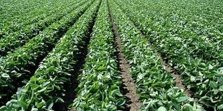
Market Support
Agriculture is more weather- and climate-dependent than many other sectors.
These business uncertainties justify the important role that the public sector plays in ensuring stability for farmers.
A number of market instruments are used to provide market safety nets

Slide 15
Income Support
Direct payments not only provide farmers with a basic income but also ensure the provision of environmental public goods

Slide 16
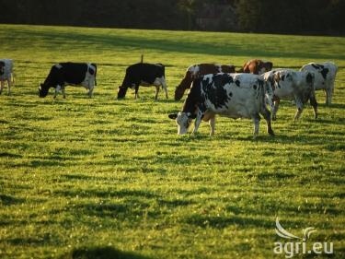
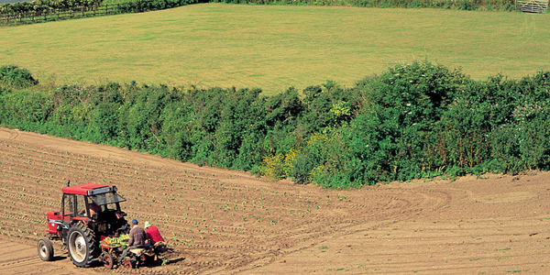
Rural Development
National (sometimes regional) programmes of development are established to address the specific needs and challenges facing rural areas
Whilst Member States compose their programmes from the same list of measures, they have the flexibility to address the issues of most concern within their respective territory reflecting their specific economic, natural and structural conditions

Slide 17
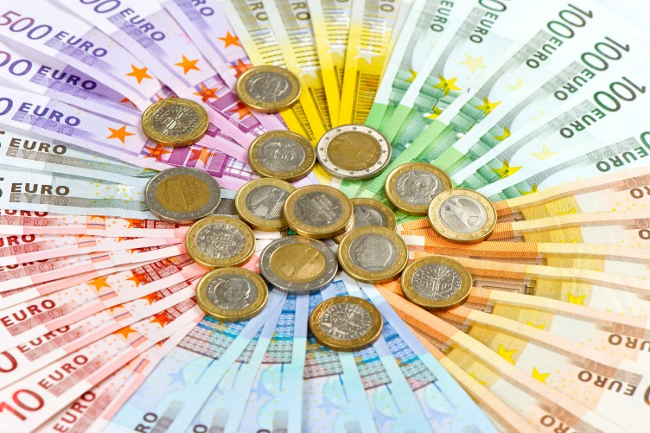
Funding CAP
As regards the funding of the CAP, there is a predetermined maximum budget (as with all EU policies) which is fixed for 7 years at a time (current programme: 2014-2020)
This ensures a ceiling on expenditure but also predictability for farmers as to what is available.
Successive policy reforms have improved the efficiency of the tools available.
Gradually the least efficient policy tools have been replaced with more efficient instruments, allowing the CAP to better respond to the needs of farmers as well as to the requirements and needs of consumers.
The first two dimensions — market support and income support — are solely funded by the EU budget, whilst the rural development dimension is based on multi-annual programming and is co-financed by Member States.

Slide 18
A policy financed by the EU budget
The budget dedicated to the CAP is considered by some people to be a controversial issue.
The statement ‘half the EU budget is dedicated to the CAP’ is frequently voiced.
Policy requires about 40% of the EU Budget.
Unlike most other policies (mainly financed by Member States), agricultural policy is mainly financed by the EU.
Placing the budget within the context of all public expenditure of the EU, the budget allocation for the policy is small (approximately 1% of all expenditure in the EU).
The budget of the common agricultural policy has decreased very sharply over the past 30 years, from almost 75% to around 40%.

Slide 19
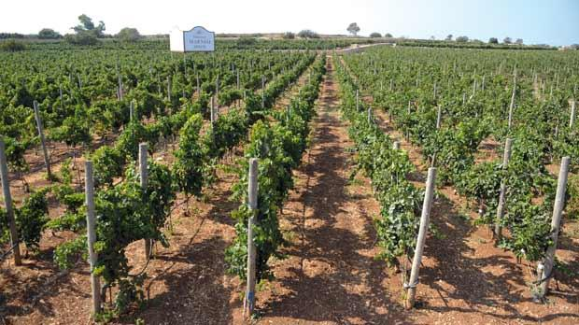
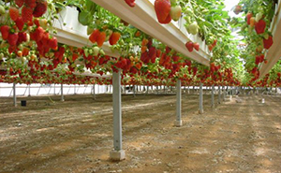
Maltese agriculture at a glance
Malta smallest EU Member State with an area of 316km²
Rural areas account for 91% of island’s territory and are home to 64% of total population.
Agricultural sector accounts for 1.7% of country’s economy (1.7% in EU-28) and 2.9% of total employment (5.1% in EU-28).
There are both less young farmers in Malta than on average in the EU-28 (3.8% vs 6%) and less older farmers (25.1% vs 30%).
Maltese holdings, with an average size of 1.2 ha, are smaller than the average EU-28 holding with a size of 14.4 ha.

Slide 20
Maltese agriculture at a glance

Slide 21
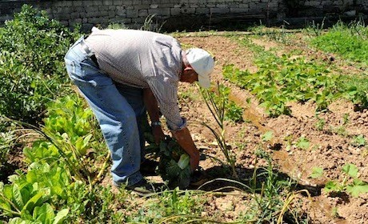
CAP in Malta
Until 2020, the new CAP is going to invest €134 million¹ in the Maltese farming sector and rural areas.
Key political priorities have been defined at European. Flexibility was given to Malta to adapt both direct payments and rural development programmes to its specific needs.
Only farmers currently active benefit from income-support schemes and young farmers are strongly encouraged to set up in business.
With a total budget of € 97 million for measures benefiting its rural areas in the period 2014-2020, Malta's rural development envelope has increased compared to the period 2007-2013

Slide 22
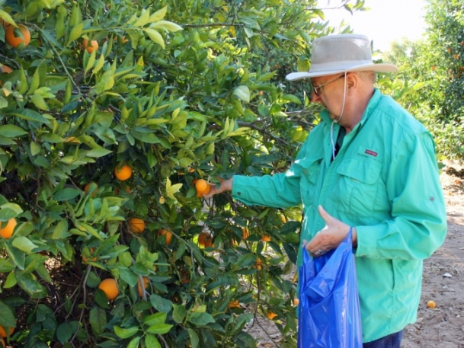
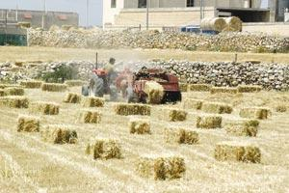
CAP in Malta
The new Rural Development Programme (approved by the Commission on November 24, 2015), focuses on 3 main objectives:
Restoring, preserving and enhancing ecosystems related to agriculture and forestry;
Increase resource efficiency and combat climate change; and
Improving competitiveness of agri-sector.
Most funds go to investments in physical assets, cooperation, Farm/business development and payments to areas facing natural or other constraints.

Slide 23
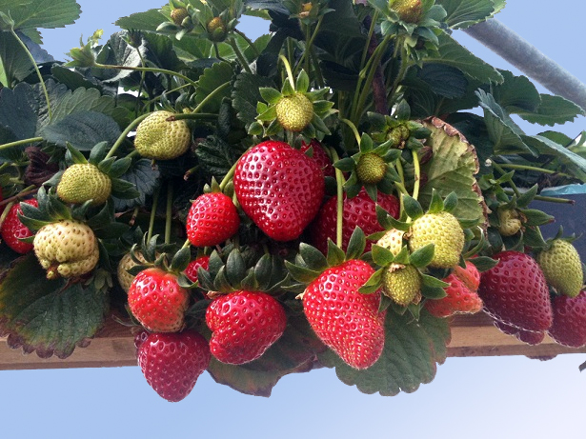
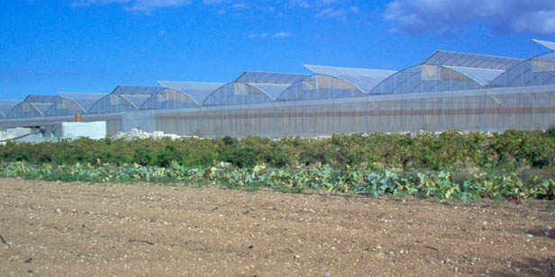
CAP in Malta (key achievements)
Between 2007-2013, CAP invested € 105 million in Malta’s farming sector and rural areas.
In 2014, Maltese farmers have received more than € 5.2 million in direct payments (benefitting 6,070).
The Rural Development Programme for 2007-2013 invested € 78 million in Maltese agricultural and rural areas.

Slide 24
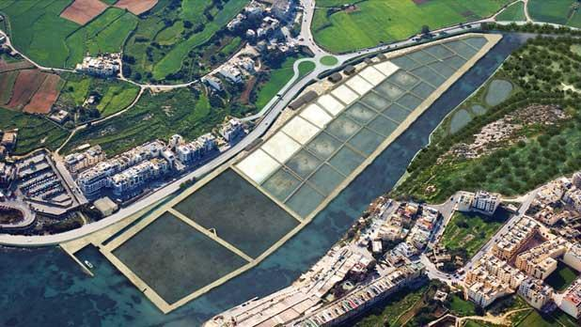
CAP in Malta (successful projects)
As the Maltese 'Salinas' host special biodiversity and constitute the only functiong wetlands in the very dry are, a Rural Development project was installed to:
prepare a management plan and guidelines for the Salini area and;
(ii) conserve and upgrade the rural area in a holistic manner to fully realise the site's considerable potential in terms of its natural and cultural assets.
(Total budget: € 6.29 million, EAFRD contribution: EUR 4.25 million).

Slide 25
Thank you
Useful links:
CAP in Malta: http://ec.europa.eu/agriculture/cap-in-your-country/pdf/mt_en.pdf
Overview of CAP reform: http://ec.europa.eu/agriculture/policy-perspectives/policy-briefs/05_en.pdf
CAP explained (EU Commission dossier): http://ec.europa.eu/agriculture/cap-overview/2014_en.pdf

